Slide 1
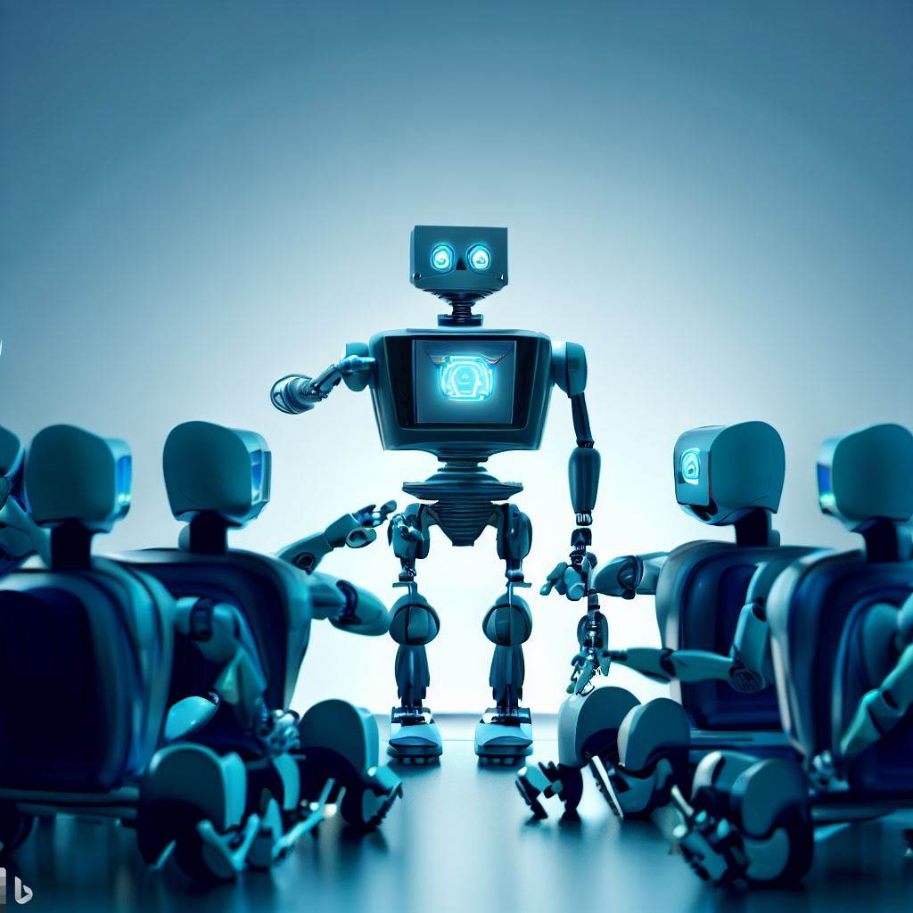
ML 101 Course
Arush Garg
AI and Machine Learning Club
Overseas Family School

Slide 2

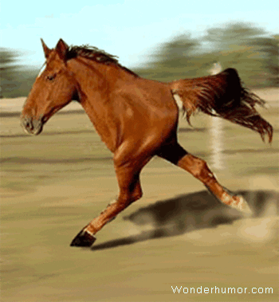
Course (bit.ly/ML_101)
Introduction to Machine Learning (ML)
Regression
Core ML concepts
Classification
Decision Trees
Model selection and tuning
Unstructured data: Text
Neural Networks
Unstructured data: Images
Introduction to Deep Learning
Beyond Regression & Classification
Notes:
Hello friends, welcome to the ML 101 course. In this course we will cover the basics on Machine Learning. It will be a pretty hands-on course with high emphasis on learning by doing. Given that this is an introductory course, we will cover a wide array of topics without getting too deep into any one topic. Each lesson comes with some “further reading material” references, for those who want to cover additional ground on their own. With that, let’s start our ML journey.

Slide 3
Course structure
11 classes, ~30 mins per class
Start with video: 10-15 mins
Hands on exercise + Q&A: 15-20 mins
(optional) practice exercises and further reading to do offline
Prerequisites
For students Grade 9 or above
Familiarity with Python would be a plus but not mandatory
Disclaimer
This is an introductory ML course. We will try to cover lot of breadth without going deep into any one single topic. Hence we are just scratching the surface with this course.
We will intentionally skip some of the core but complex mathematical concepts behind ML model training.

Slide 4
Tools / Technologies
Github
(optional but recommended) Create a github account
This is where you will find all the course content: slides, exercises, instructions etc
Python
Most used programming language for Data Science & Machine Learning
Google Colab (Jupyter Notebooks)
Most popular IDE (Integrated Development Environment) for Data Science

Slide 5
01 Introduction to ML
ML 101 Course
Notes:
No surprises that our first lesson is titled “introduction to machine learning”. But you might be surprised to know that before the end of this lesson, you will get hands-on experience training your first ML model. So, pay attention.

Slide 6
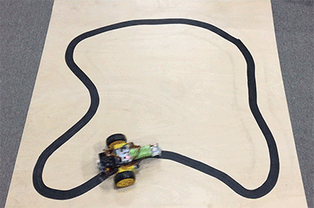
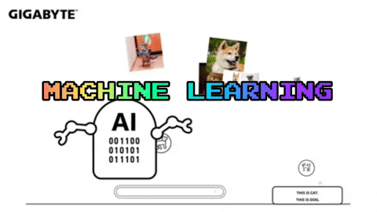
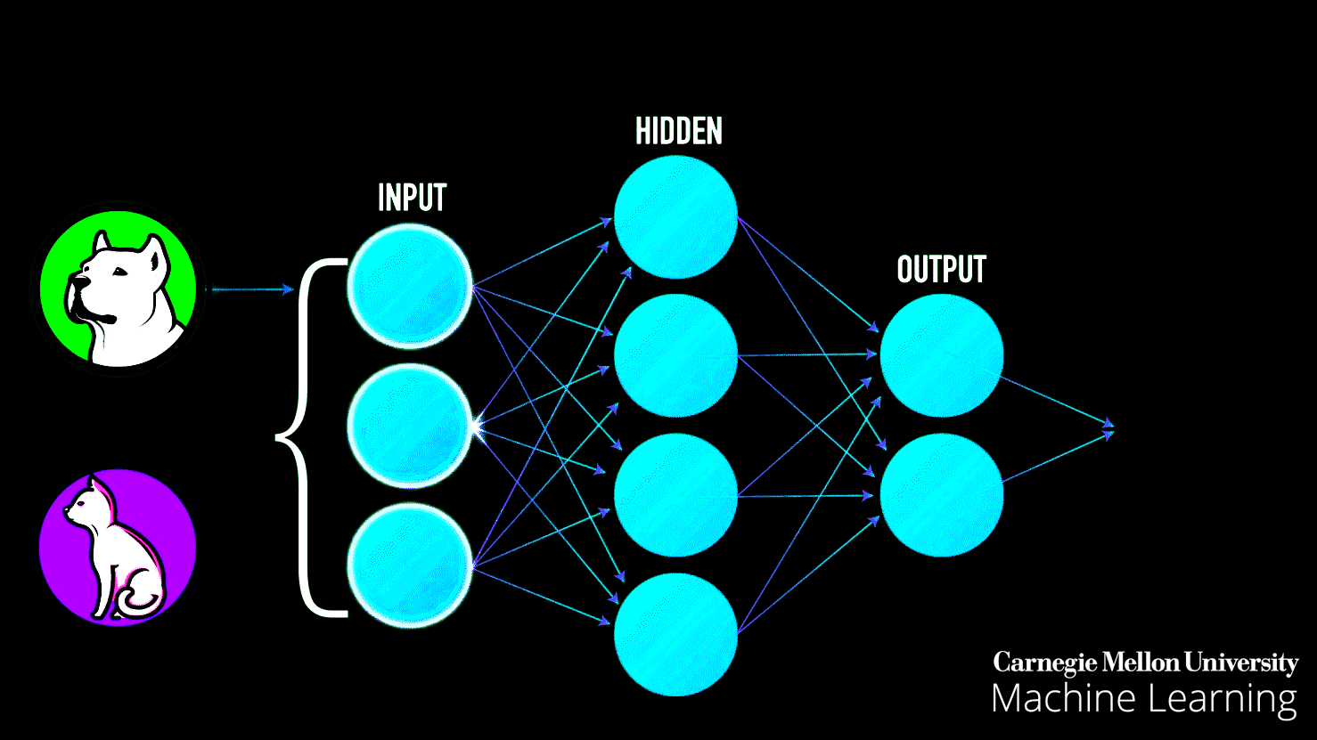
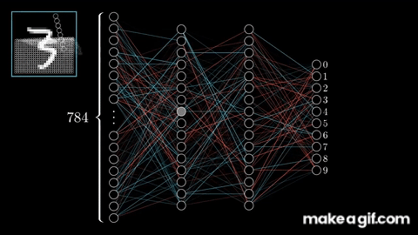
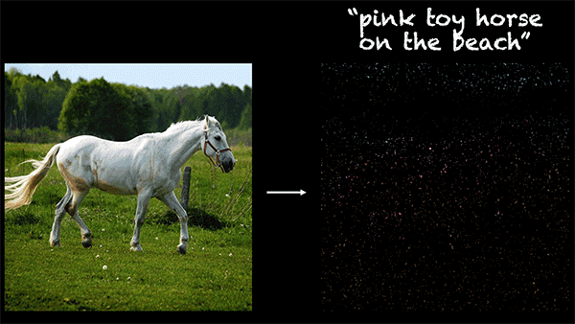
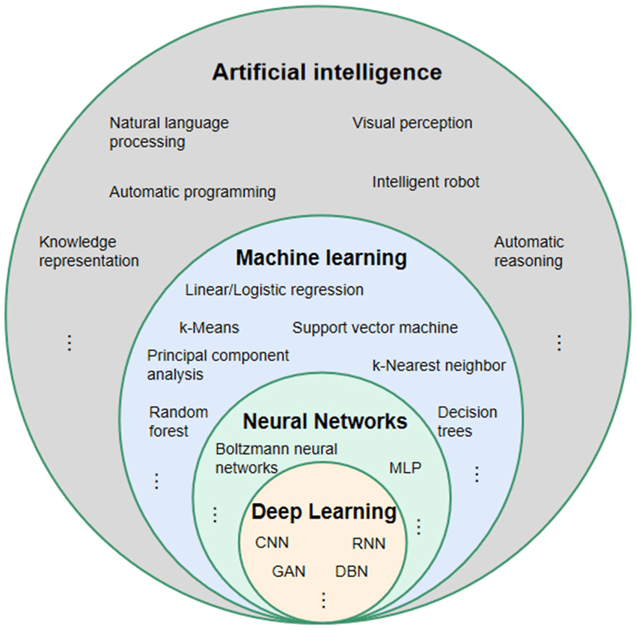
AI vs ML vs DL vs Generative AI …
Focus of this course: Classical ML
AI is the ability of a machine to imitate intelligent human behavior. In addition to ML, Robotics and Automation are other two big fields under AI.
Application of AI that allows a system to automatically learn and improve from experience, without being explicitly programmed.
NN is a specific type of ML model that is inspired by the structure and functioning of the human brain. It consists of interconnected processing units, called neurons, organized in layers.
DL employs complex neural networks with multiple layers, often referred to as "deep" networks. These networks are designed to automatically learn and represent intricate patterns from raw data.
Generative AI focuses on creating new content or data that is novel and resembles human-created content. One of the most promising applications of Deep Learning.
Image Source: ResearchGate
Notes:
You might have heard of many these terms related to ML and felt confused what is what. AI is a very broad term used for any machine capability that mimics intelligent human behavior. Lot of AI capabilities leverage machine learning for intelligent decision making, but that’s not a prerequisitie. E.g. a line following robot can be called an AI but we can implement it without using machine learning.
Then comes Machine Learning which covers the science of getting computers to learn without being explicitly programmed. We will discuss this further on the next slide.
Neural networks are one specific type of ML models that consists of multiple interconnected processing units, each unit is a small ML model in itself.
Deep Learning is a extension of NN as we increase the number of layers and connections. Deep learning has really revolutionized the field of ML in the last decade and is used heavily for complex ML applications like speech recognition, image classification and generative AI
In this course we will introduce Deep Learning but the focus will be what is commonly called “classical machine learning”. This course will lay the foundation to better understand Deep Learning concept in the future, a possible ML 201 course.
And in case you were wondering where Generative AI sits, it is the innermost circle here. It is a specific application of machine learning and almost all prominent generative AI models are trained using Deep Learning.

Slide 7
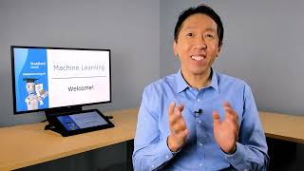
ML Applications
Web Search
Face Recognition
Recommendation
Speech Recognition
Spam Detection
Industrial Optimization
Medical Diagnosis
Defect Detection
…
Machine Learning Specialization Course by DeepLearningAI [link]
Notes:
Before we start learning about machine learning, let’s understand “where is machine learning being used”

Slide 8
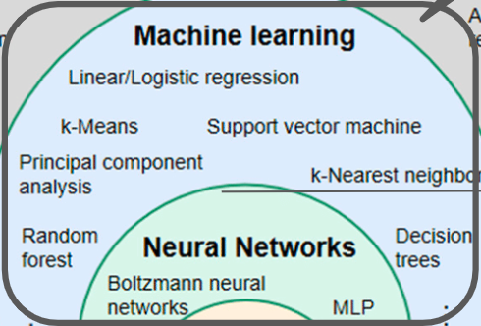
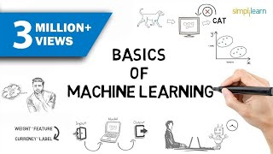
Types of Machine Learning
Science of getting computers to learn without being explicitly programmed
Primary focus of this course. Will cover other two in brief.
Supervised Learning: machine learns from a labeled dataset. Most popular and common.
Unsupervised Learning: machine finds patterns from unlabelled data
Reinforcement Learning:
machine learns to perform tasks based on reward / punishment feedback loop
Video Source: Simplilearn

Slide 9
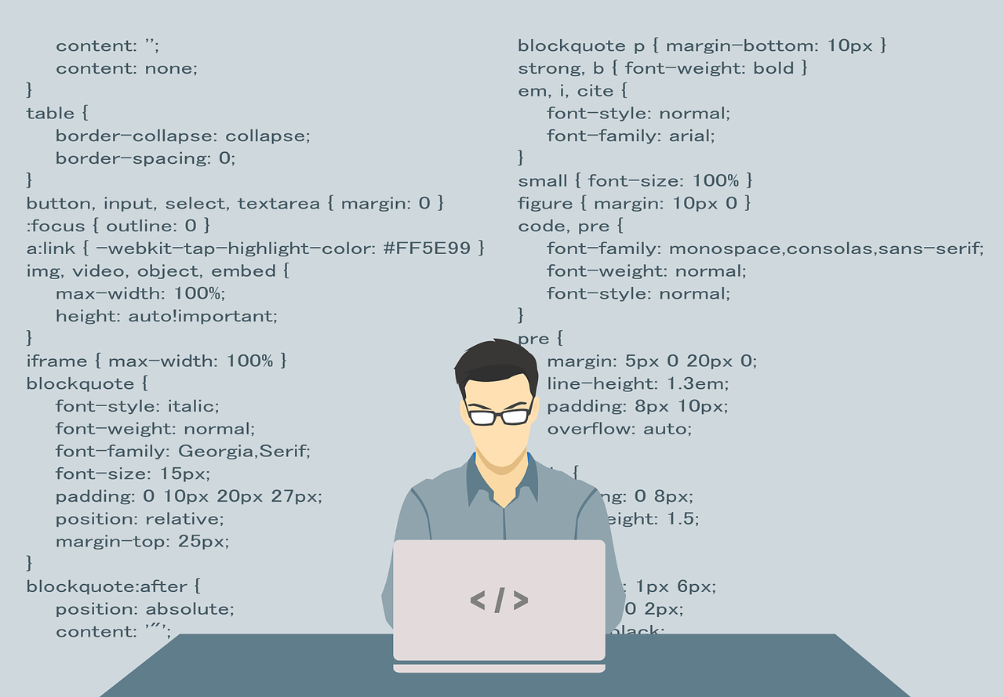


Traditional Programming vs Machine Learning
E.g. a website that shows flight schedule or an app that allows you to play chess against another human
E.g. ML model that can predict “flight delay” or “play chess”
Data is sent as input to ML algorithms
2
ML Algorithms
Human writes code (software) that captures the logic & algorithms defining “how to process the input / data”
Human prepares data that contains historical data points to learn from
3
1
1
Output is a trained ML model
Software is deployed on a machine
2
ML model is deployed on a machine
Users sends request / input that is similar to the data on which the ML model was trained
4
Users sends request / input
5
3
Software
5
Output is sent to the user
4
Software processes the input and produces the output
6
ML model makes a prediction based on input data
Notes:
We have mentioned that in Machine Learning we do not explicitly program the machine to perform a specific task. Let’s understand this concept in more detail. In case of programming a human writes code that contains the explicit instructions regarding how to process a particular input. That code is then deployed on a machine. When a user sends a request, the software follows the instructions and generates the output.
But in case of Machine Learning the key task human performs is around preparing the data that is fed into pre-existing ML algorithms. The output of this process is a trained ML model. This ML model is then deployed on a machine. When this model receives new input data as a request, it makes a prediction based on what it learnt. We will go through all these steps in the hands-on exercise today.

Slide 10
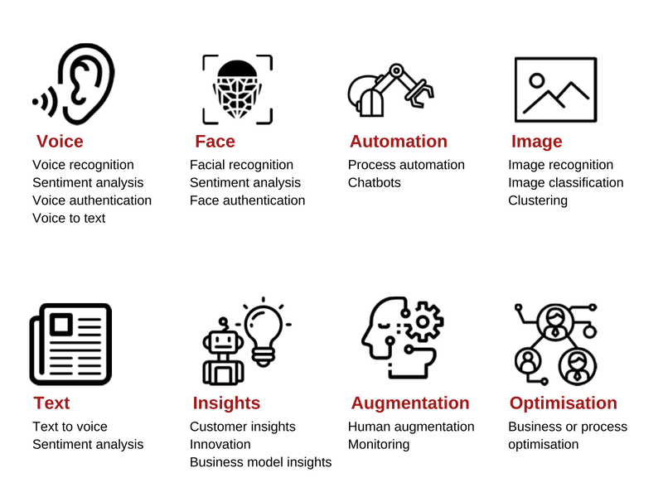
ML Application Examples
Image Source: AddAxis

Slide 11
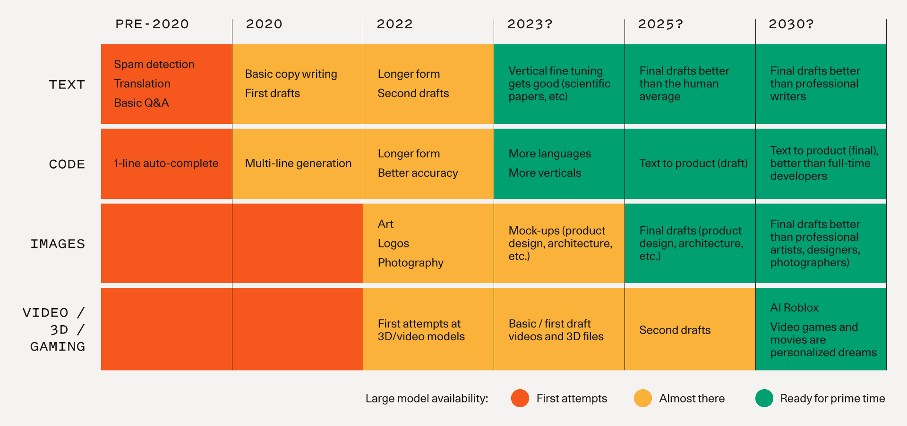
Generative AI Applications
Image Source: Sequoia

Slide 12
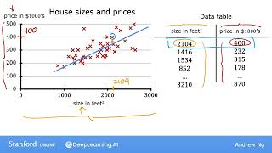
Supervised Learning example: Linear Regression
Predict the price of the house based on the size of the house
Machine Learning Specialization Course by DeepLearningAI [link]
Notes:
Now it is time to get familiar with the most basic ML model called Linear Regression.

Slide 13
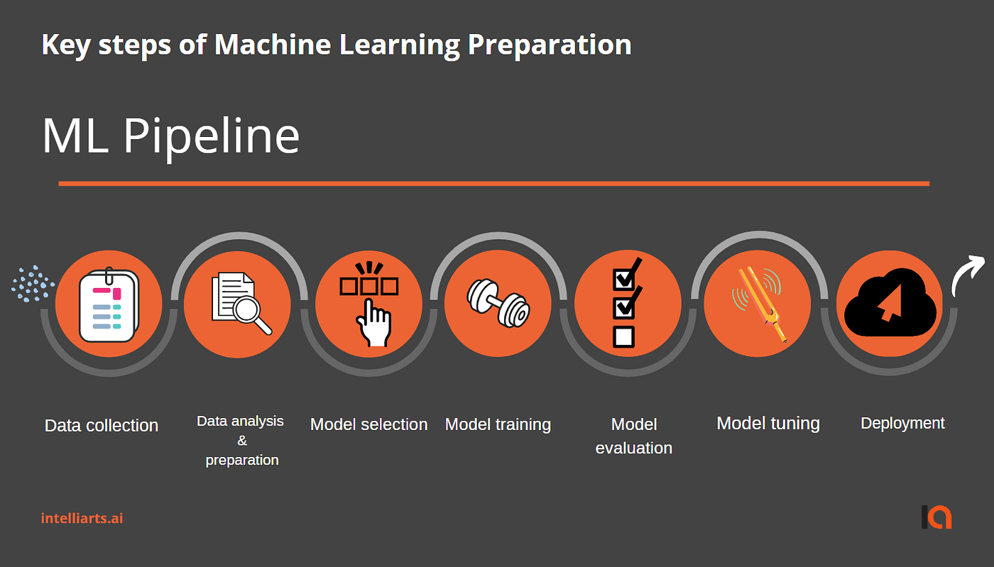
Supervised Learning: steps involved

Slide 14
Hands-on Exercises
Explore the basics of Python and Jupyter Notebooks:
Google Colab (if you do not have VS Code or other Jupyter Notebook software)
Open this file in Colab: https://github.com/techno-nerd/ML_Course/blob/main/01%20Introduction/Python101.ipynb
Follow the instructions in Jupyter notebook
Train your first model:
Open this file in Colab: https://github.com/techno-nerd/ML_Course/blob/main/01%20Introduction/FirstModel.ipynb
Follow the instructions in Jupyter notebook

Slide 15
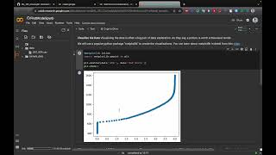
Hands-on Exercise:
Train Linear Regression model to predict SAT score based on GPA
Notes:
Here are the instructions for this lesson’s hands on exercise.

Slide 16


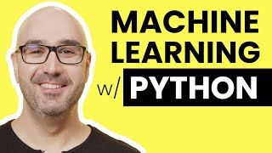
Further Reading / Watching / Doing
ML 101 Course github link (bit.ly/ML_101)
Files
“/01 Introduction/FirstModel.ipynb”
“/01 Introduction/Python101.ipynb”
Python for Beginners: Programming with Mosh [link]
Covers overview of:
Jupyter Notebooks
Trains an ML model, covering all steps
Most popular python packages for ML: Numpy, Pandas, Sklearn
Instead of installing the Jupyter server on your machine, you can also use free online Jupyter notebook servers like Google Colab
Python Machine Learning Tutorial: Programming with Mosh [link]
Notes:
Here you can find some relevant resources to go through offline

Slide 17
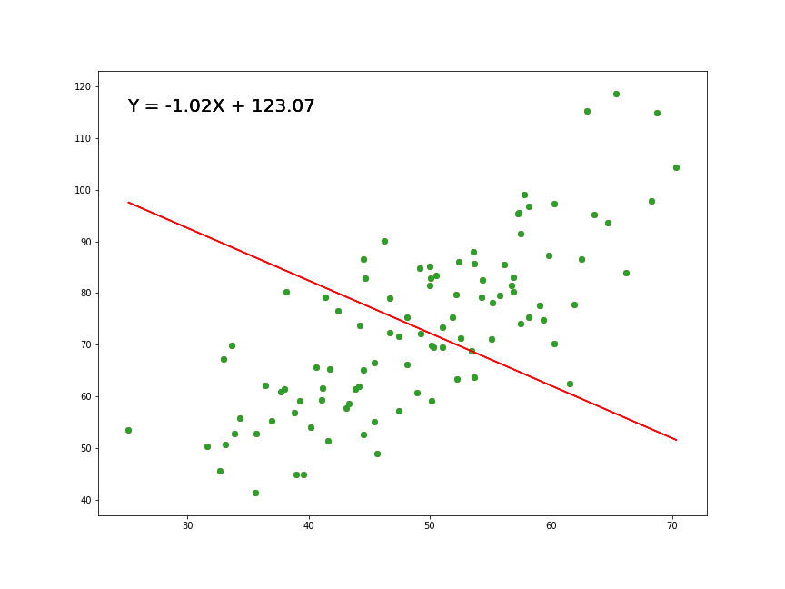
Agenda for next class
Go deeper into “Linear Regression”
Get familiar with key ML terminology that will be used in the rest of the course
Understand the mathematical expression behind “linear regression”
How to use linear regression for data with non-linear correlation
Notes:
This brings us to the end of first lesson. In the next lesson we will dive deeper into Linear Regression model

